Slide 1
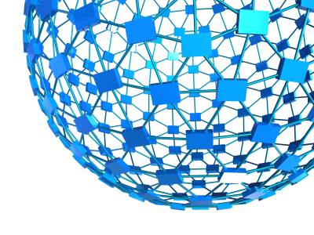


Association Rules with Graph Patterns
Wenfei Fan Jingbo Xu
Xin Wang
Yinghui Wu
Southwest Jiaotong University
Washington State University
University of Edinburgh
Notes:
Title page.
Introduction.
Good morning everyone! I’m glad to be here with you today. And I’m going to
talk about big graph search and analytics. Feel free to interrupt me if you have any questions during my talk .

Slide 2



Association in social networks
Traditional association rules:
X ⇒ Y
Association in social networks
French restaurant
“if customers x and x′ are friends living in the same city c, there are at least 3 French restaurants in c that x and x′ both like, and if x′ visits a newly opened French restaurant y in c, then x may also visit y.”
y
visit
x
x’
city
French³ restaurant
Association with topological constraints!
Identify customers for a new French restaurant

Slide 3




Association via graph patterns
x₂
“fake”
acc #1
acc #2
x₁
x
Ecuador
article
blog
blog
“Shakira”
album
“claim a prize” (keywords)
Identify customers for released album
detect fake account
Question 1: How to define association rule via graph patterns?
Question 2: How to discovery interesting rules?
Question 3: How to use the rules to identify customers?

Slide 4




Graph Pattern Association Rules (GPARs)
graph-pattern association rule (GPAR) R(x, y)
R(x, y): Q(x, y) ⇒ q(x, y)
Q(x, y): a graph pattern; where x and y are two designated nodes
q(x, y) is an edge labeled q from x to y (predicate)
Q and q as the antecedent and consequent of R, respectively.
French restaurant
French restaurant
French restaurant
x
:
⇒
x’
x
x’
x
city
French³ restaurant
city
French³ restaurant
R(x, French restaurant):
Q(x, French restaurant) ⇒ like(x, French restaurant)

Slide 5
Graph Pattern Association Rules (GPARs)
graph-pattern association rule (GPAR) R(x, y)
R(x, y): Q(x, y) ⇒ q(x, y)
If there exists a match h that identifies v_{x} and v_{y} as matches of the designated nodes x and y in Q, respectively, then the consequent q(v_{x} , v_{y}) will likely hold.
“if x and x′ are friends living in city c, there are at least 3 French restaurants in c that x and x′ both like, and if x′ visits a newly opened French restaurant y in c, then x may also visit y.”
French restaurant
French restaurant
French restaurant
x
:
⇒
x’
x
x’
x
city
French³ restaurant
city
French³ restaurant
R(x, French restaurant):
Q(x, French restaurant) ⇒ like(x, French restaurant)

Slide 6



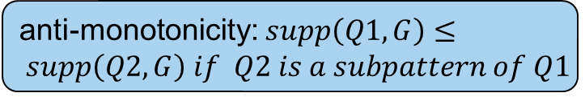
Support and Confidence
⇒
Support of R(x, y): Q(x,y) p(x,y)
$$supp(Q, G)=|Q(x, G)|$$
# of isomorphic subgraph in single graph?
anti-monotonicity: $supp\left(Q1,G\right)≤ supp\left(Q2, G\right) if Q2 is a subpattern of Q1$
Le Bernadin
French restaurant
Per se
⇒
u₁
u₂
u₃
x
x’
French³ restaurant
New
York (city)
city
French³ restaurant
French³ restaurant

Slide 7
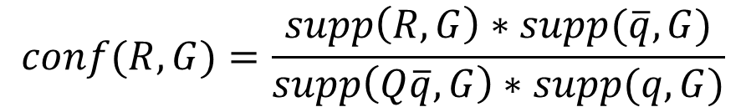
Support and Confidence
Candidate # of x with one edge of type q but is not a match for q(x,y)
Confidence of R(x, y)
$$conf(R, G)=\frac{supp\left(R, G\right)∗supp(\overline{q},G)}{supp\left(Q\overline{q}, G\right)∗supp(q,G)}$$
Local closed world assumption
x₂
v₂
x₁
x
v₁
v
v'
v''
hobby
Ecuador
Shakira album
MJ’s album
Pop music
Ecuador
Shakira album
“positive”
“negative”
“unknown”

Slide 8





Discover GPARs
Mining GPARs for particular event – often leads to same group of entities
Difference function
French restaurant
French restaurant
y
Diversified GPARs
y
$$diff(R1, R2)=\frac{PR1 (x, G)∩PR2 (x, G)}{PR1 (x, G)∪PR2 (x, G)}$$
x
x
X’
x
Bi-criteria Diversification function
Asian restaurant
city
French² restaurant
city
$$F\left(S\right)=\left(1−λ\right)\sum_{Ri}{\frac{conf(Ri)}{N}+\frac{2λ}{k−1}\sum_{Ri, Rj∈S, i<j}{diff(Ri, Rj)}}$$
Le Bernadin
Per se
Patina
Asian restaurant
The diversified mining problem:
u₁
u₂
u₃
u₄
u₅
u₆
Given a graph G, a predicate q(x, y), a support bound and positive integers k and d, find a set S of k nontrivial GPARs pertaining to q(x, y) such that (a) F(S) is maximized; and (b) for each GPAR R ∈ S, supp(R,G) ≥ α and r(PR, x) ≤ d.
New
York (city)
LA
(city)
Asian restaurant
French³ restaurant
French³ restaurant
French³ restaurant

Slide 9
Parallel GPAR Discovery
A parallel GPAR discovery algorithm DMine
coordinator S_{c} divides G into n-1 fragments, each assigned to a processor S_{i}
discovers GPARs in parallel by bulk synchronous processing in d rounds
S_{c} posts a set M of GPARs to each processor
each processor generates GPARs locally by extending those in M
new GPARs are collected and assembled by S_{c} in the barrier synchronization phase; S_{c} incrementally updates top-k GPARs set L_{k}
L_{k}
R₁
R₂
…
R_{k}
Assembled
New GPARs M_{i+1}
coordinator
3. Synchronization/ Update L_{k}
1. Distribute M_{i}
worker 1
worker 2
…
worker n
2. Locally expand M_{i}
Notes:
Give a figure

Slide 10
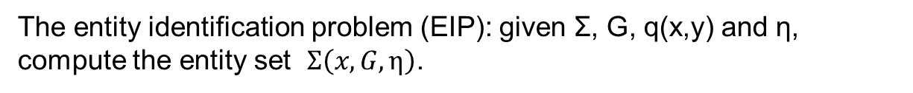
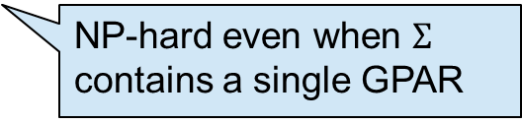
Identifying entities using GPARs
Given a set of GPARs Σ pertaining to the same q(x,y), graph G and confidence threshold η, the set of entities identified by Σ is the set
$$Σ\left(x, G, η\right)=\{v|v∈Q\left(x, G\right), Q(x, G)\underset{⇒}{}q(x,y)∈Σ, conf(R, G)≥η\}$$
The entity identification problem (EIP): given Σ, G, q(x,y) and η, compute the entity set $Σ\left(x, G, η\right)$.
NP-hard even when $Σ$ contains a single GPAR

Slide 11
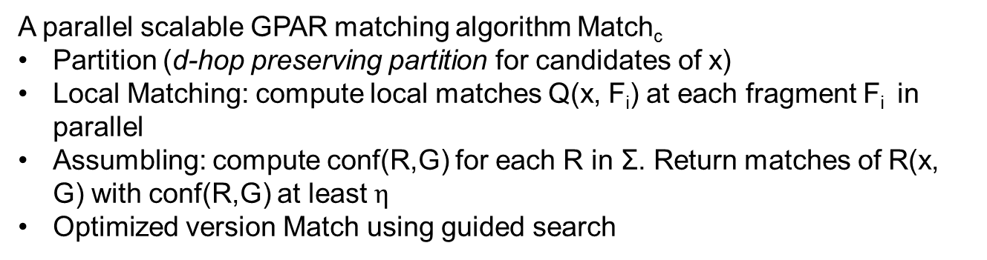
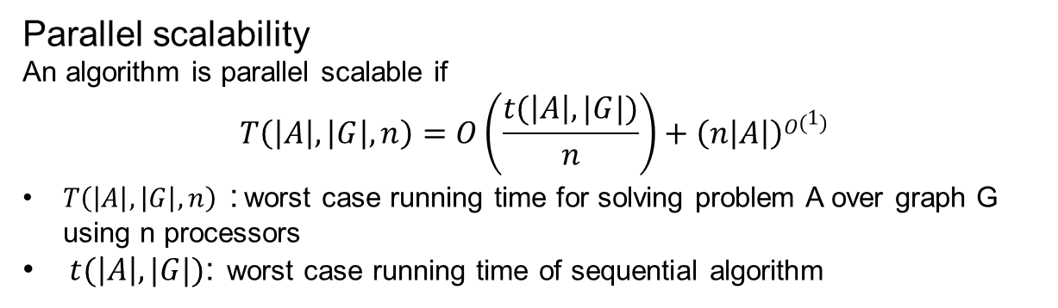
Entity Identification algorithm
Parallel scalability
An algorithm is parallel scalable if
$$T\left(\left|A\right|,\left|G\right|, n\right)=O\left(\frac{t(\left|A\right|,|G|)}{n}\right)+\left(n\left|A\right|\right)O\left(1\right)$$
$T\left(\left|A\right|,\left|G\right|, n\right)$ : worst case running time for solving problem A over graph G using n processors
$t(\left|A\right|,|G|)$: worst case running time of sequential algorithm
A parallel scalable GPAR matching algorithm Match_{c}
Partition (d-hop preserving partition for candidates of x)
Local Matching: compute local matches Q(x, F_{i}) at each fragment F_{i} in parallel
Assumbling: compute conf(R,G) for each R in Σ. Return matches of R(x, G) with conf(R,G) at least $η$
Optimized version Match using guided search

Slide 12
Experimental study
We used real-world social networks
Pokec: 1.63 million nodes of 269 different types, and 30.6 million edges of 11 types (follow, like)
Google+: 4 million entities of 5 types and 53.5 million links of 5 types.
Algorithms:
DMine vs DMine without optimization and GRAMI*
Match_{c} vs disVF2, Match and Match_{S}
* M. Elseidy, E. Abdelhamid, S. Skiadopoulos, and P. Kalnis.GRAMI: frequent subgraph and pattern mining in a single large graph. PVLDB, 7(7):517–528, 2014.

Slide 13
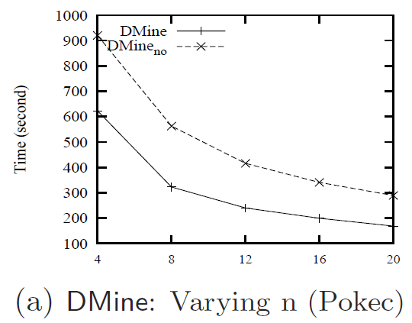
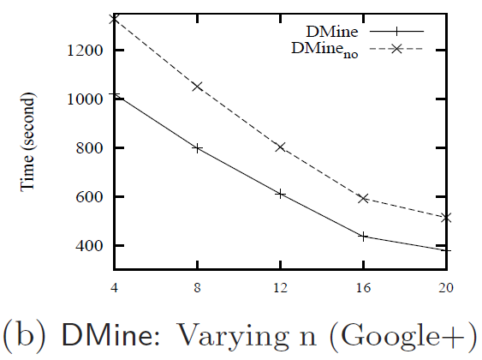
Scalability of discovery algorithm
On average 3.2 time faster

Slide 14
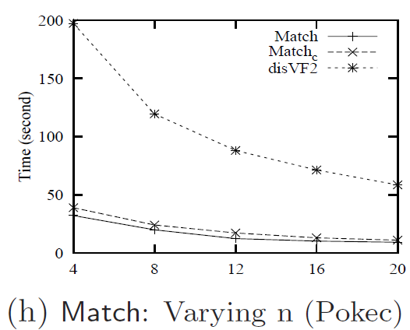
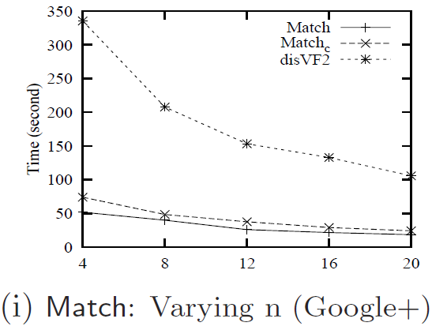
Scalability of Entity identification
On average 3.53 time faster
Find matches for 24 GPARs over G of size 150M in 45s, using 20 processors

Slide 15
Conclusion and future work
Association rules in social and information networks are more involved
We propose association rules with graph patterns (GPARs) from syntax, semantics to support and confidence.
We studied DMP and EIP problem, for GPARs discovery and identifying potential customers with GPARs.
We show that it is feasible to discover and make practical use of GPARs over large networks
Future work
Extend GPARs by supporting graph patterns as consequent
Allow more types of graph pattern matching semantics

Slide 16


Association Rules with Graph Patterns
Thank you!

Slide 17


GPARs discovery examples
Disco
“if x follows user1, user1 follows user2, user2
follows x, user1 and user2 share the hobby to listen to music, x and user1 share the hobby of party, and if user2 likes Disco music, then x likes Disco. “
usr₂
usr
usr₁
listen to music
party
usr₂
usr
“if x and x′ follow each other and both like
books of profession development, and if x′ likes books about personal development, then so does x.”
Professional development
personal development
Computer science
“if x follows x′, both x and x′ went to
CMU, both x and x′ are employees of Microsoft, and if x′
was majored in CS, then x was also likely majored in CS.”
x
x’
CMU

Slide 18
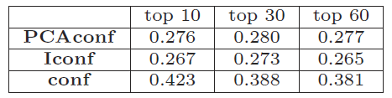
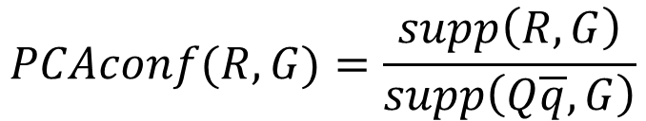
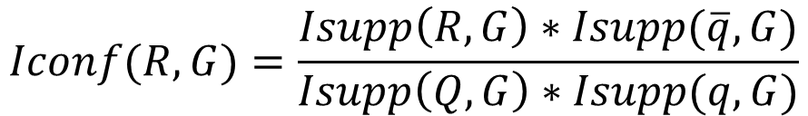
GPARs with Different confidence measures
$$PCAconf(R, G)=\frac{supp\left(R, G\right)}{supp\left(Q\overline{q}, G\right)}$$
$$Iconf(R, G)=\frac{Isupp\left(R, G\right)∗Isupp(\overline{q},G)}{Isupp\left(Q, G\right)∗Isupp(q,G)}$$

Slide 19
Pattern matching semantics
We use subgraph pattern defined by subgraph isomorphism
Match Q(G): the set of all isomorphic subgraphs
Q(x, G): {u₁, u₂, u₃}
Le Bernadin
French restaurant
Per se
⇒
u₁
u₂
u₃
x
x’
French³ restaurant
New
York (city)
city
French³ restaurant
French³ restaurant

Slide 20

Discovery Algorithm
Key components:
Local generation of GPARs:
expand an existing GPAR by adding new (frequent)edges
construct local support and confidence as messages
Message Assembling
assembles global support/confidence for the same GPAR R
retain R with high support in a cached new GPARs set
Incremental Maintenance of Lk
select two GPARs Ri, Rj that maximizes a revised object function
simulates max-dispersion problem
Optimization
Candidate GPARs filtering using estimated confidence upperbound
Automorphism checking via bisimulation as preprocessing
French restaurant
x
x’
city
French³ restaurant
Notes:
Give a figure

